Slide 1
How to download NLDAS2 data
By Bennett McAfee
re-using lots of code from Patricia Tran, Hilary Dugan, and Robert Ladwig

Slide 2
1. Installing the right programs
Install wget. Windows tutorial: https://youtu.be/cvvcG1a7dOM?si=zmkcHz5SeWw1yqa9
Install R and Rstudio

Slide 3
install wget on mac
Slide courtesy of Sophia Skoglund
copy-paste or type the following into the Terminal
check if wget is installed (if not, proceed)
install homebrew
install wget
if “brew” is not found, enter these lines one at a time to change the :PATH
try step 3 again
wget -V
/bin/bash -c "$(curl -fsSL https://raw.githubusercontent.com/Homebrew/install/HEAD/install.sh)”
brew install wget
echo 'eval $(/opt/homebrew/bin/brew shellenv)' >> ~/.zprofile
eval $(/opt/homebrew/bin/brew shellenv)

Slide 4
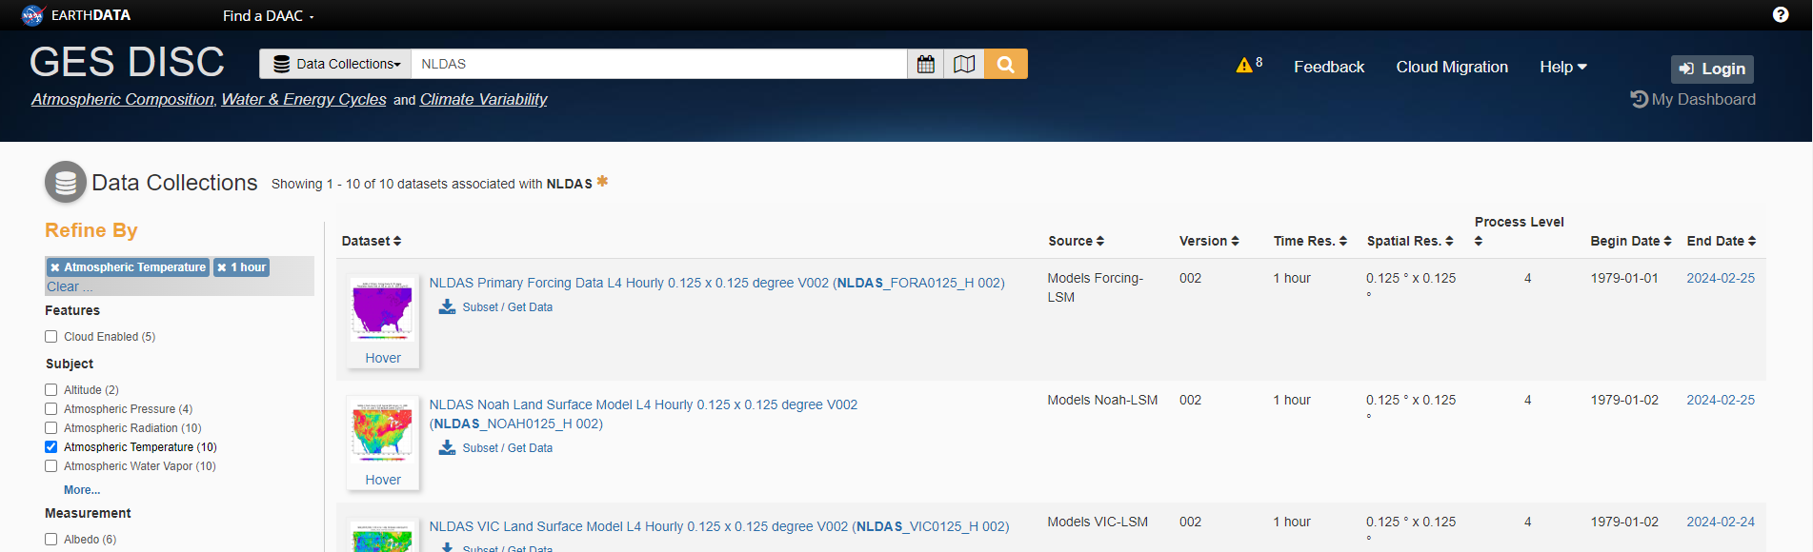
Get the list of URLs
Head to https://disc.gsfc.nasa.gov/datasets?keywords=NLDAS&page=1
If you do not have an account, click Login and make one. Then return to this page
Click on “NLDAS Primary Forcing Data L4 Hourly 0.125 x 0.125 degree V002 (NLDAS_FORA0125_H)”

Slide 5
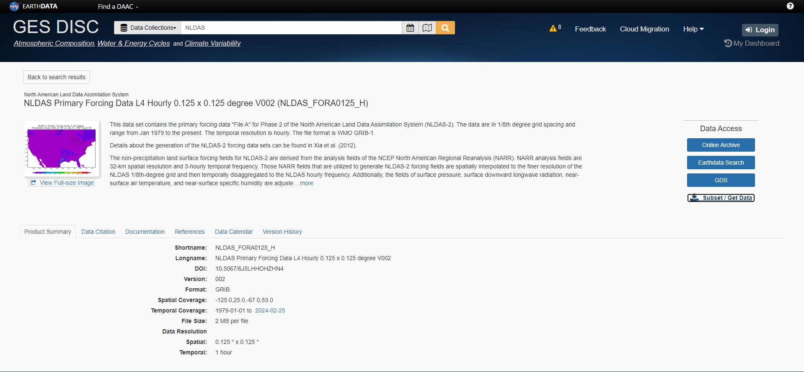
2. Get the list of URLs
Click on your data package of interest and then go to “Subset/Get Data”

Slide 6
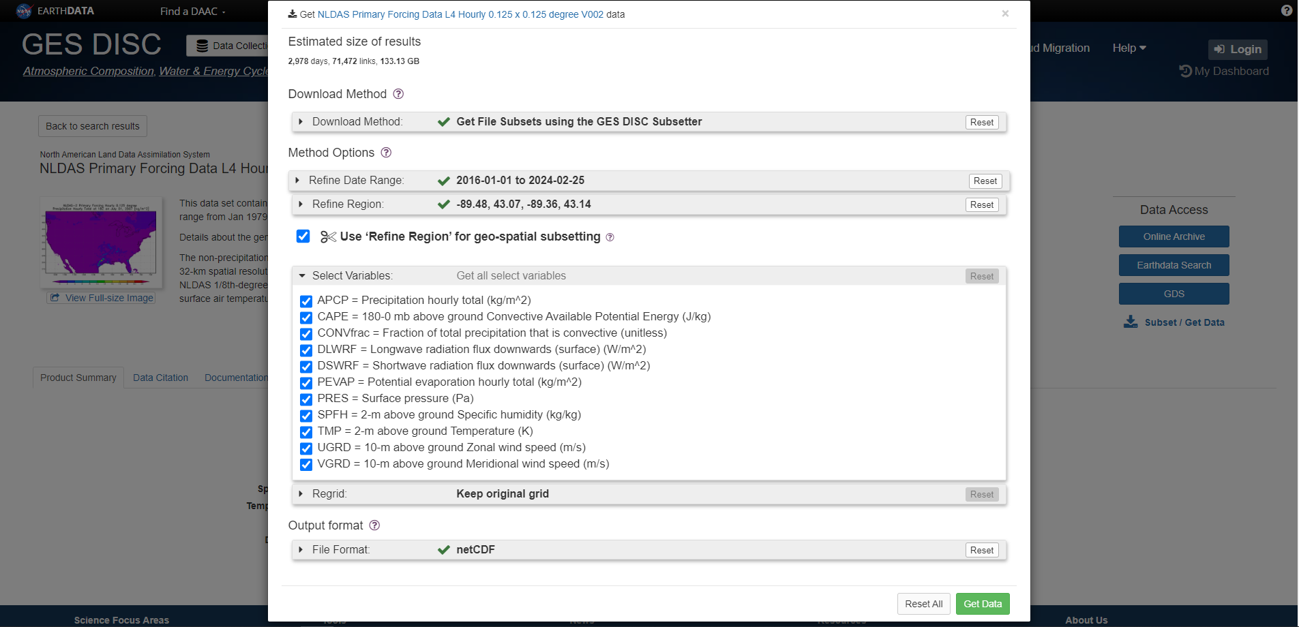
2. Get list of URLs
Select the settings below, adjusting your timeframe.
For the LakeGPT project, we are using the full date range available. Region can be found in this Google Sheet: https://docs.google.com/spreadsheets/d/1JR96nbEtn4JhtvNl6k4Z4wXfk_mshi-n-Mwhuom62zY/edit?usp=sharing
Feel free to claim any lake that nobody else is working on.

Slide 7
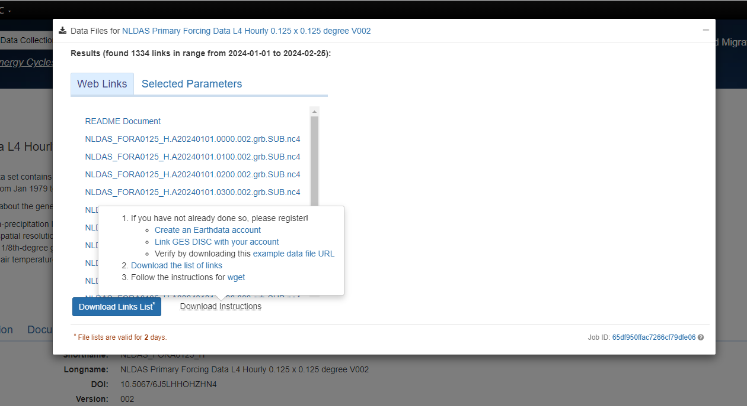
2. Get list of URLs
Follow the instructions in steps 1 and 2 of “download instructions” to set up your Earthdata account
Click ‘Download Links List’ to get the list of links. Store this list in your R directory

Slide 8
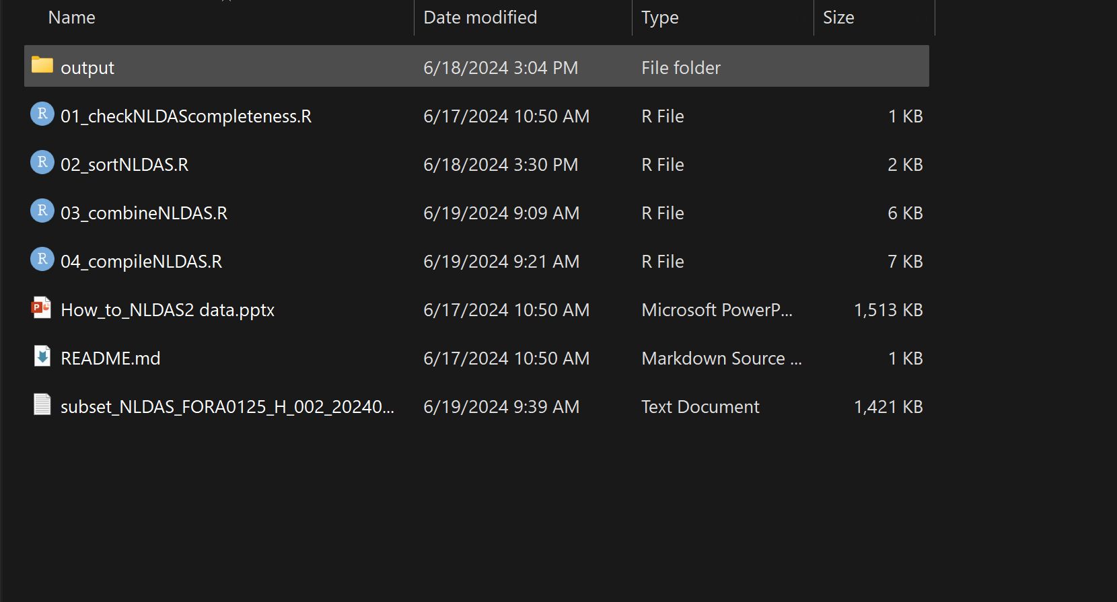
3. Save your list of links to your project the folder alongside your R scripts. Create a folder called ‘output’ in your directory if it does not already exist

Slide 9
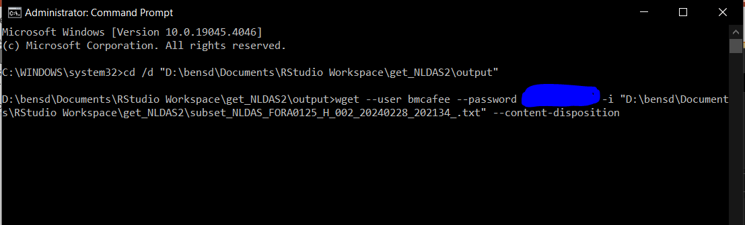
4. In the command prompt (run as administrator)
Change your directory to the output folder next to the R scripts
Run the following command:
wget --user [Earthdata username] --password [Earthdata password] -i [text_file_downloaded] --content-disposition
Note that this process will take days of uninterrupted internet connection. However, you can start the process where you left off using steps 5 and 6.

Slide 10
5. wget will retrieve most of the files, but many downloads will fail.
Edit line 6 of 01_checkNLDAScompleteness.R to point to your list of links
Run 01_checkNLDAScompleteness.R. This may take a few minutes.
Check todownload.txt to make sure it includes the files that were not previously downloaded.

Slide 11
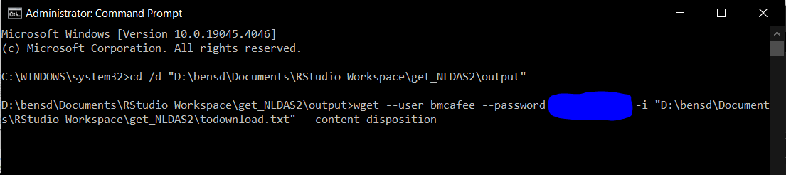
6. Run wget again, but pointing to todownload.txt
In command prompt, change your directory to the output folder next to the R scripts
Run the following command:
wget --user [username] --password [password] -i [directory/todownload.txt] --content-disposition

Slide 12
7. Repeat steps 5 and 6 until there are no missing files. This may take many repetitions.

Slide 13
8. Run 02_sortNLDAS.R
Be sure to set the Lake Name on line 4. Use underscores instead of spaces (e.g. “Trout_Lake”)
This may take a few minutes.

Slide 14
8. Run 03_combineNLDAS.R
Be sure to set the Lake Name on line 19. Use the same name as 02_sortNLDAS.R
If the number of cells is known, enter it on line 66. If unknown, 6 will work.
This process will take a few hours or days.

Slide 15
9. Run 04_compileNLDAS.R
Be sure to set the
Lake name (line 5) (same as 02_sortNLDAS.R)
Lake time zone (line 6) (available on the Google Sheet)
Number of cells (line 7) (if known, same as 03_combineNLDAS.R)
This process will take a few minutes

Slide 16
10. Your final files will be in the [LakeName]_Final folder
Reach out to me (Bennett, bmcafee@wisc.edu) once completed. I will work with you on how to get the files to me.

Slide 17
Thank you for all your help!

